Slide 1
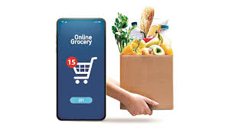

Trends among Indian states and UTs in using online platforms to buy food articles
Research Scholar
Varshini Balasubramanya
Christ (Deemed to be University)
Date: 27th October, 2024

Slide 2
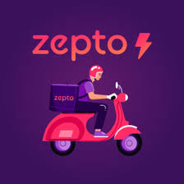

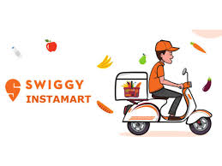
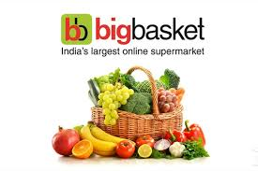

Introduction
The widespread accessibility of mobile internet, along with the growth of e-commerce and omnichannel distribution, has significantly expanded the e-commerce industry.
However, the COVID-19 pandemic and associated restrictions disrupted traditional shopping habits, leading to a marked increase in consumers purchasing perishables and groceries online. (Mandloi et al., 2021)
Quick commerce has significantly disarranged the e-commerce landscape, particularly during the COVID-19 pandemic, by meeting the rising consumer demand for rapid delivery of daily essentials like groceries and medications.
This model emphasizes swift doorstep deliveries, catering to consumers' needs for convenience and efficiency in their busy lifestyles.(Stojanov, 2022) (Patil et. al, 2021)
.

Slide 3
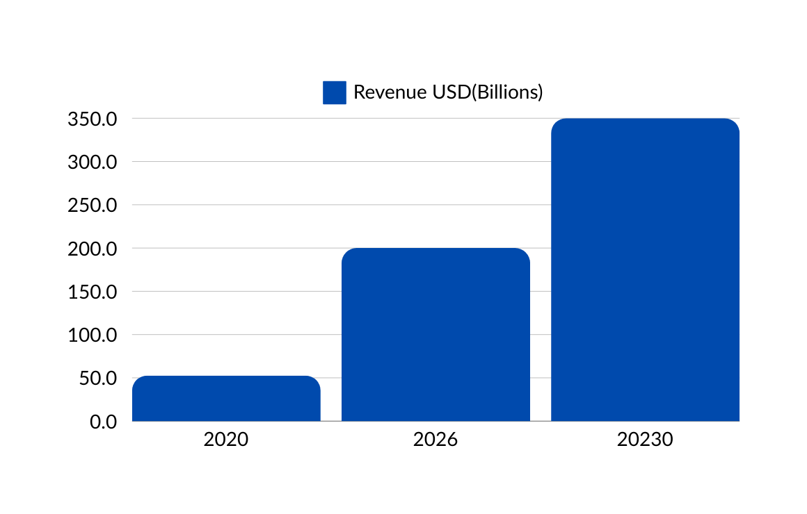
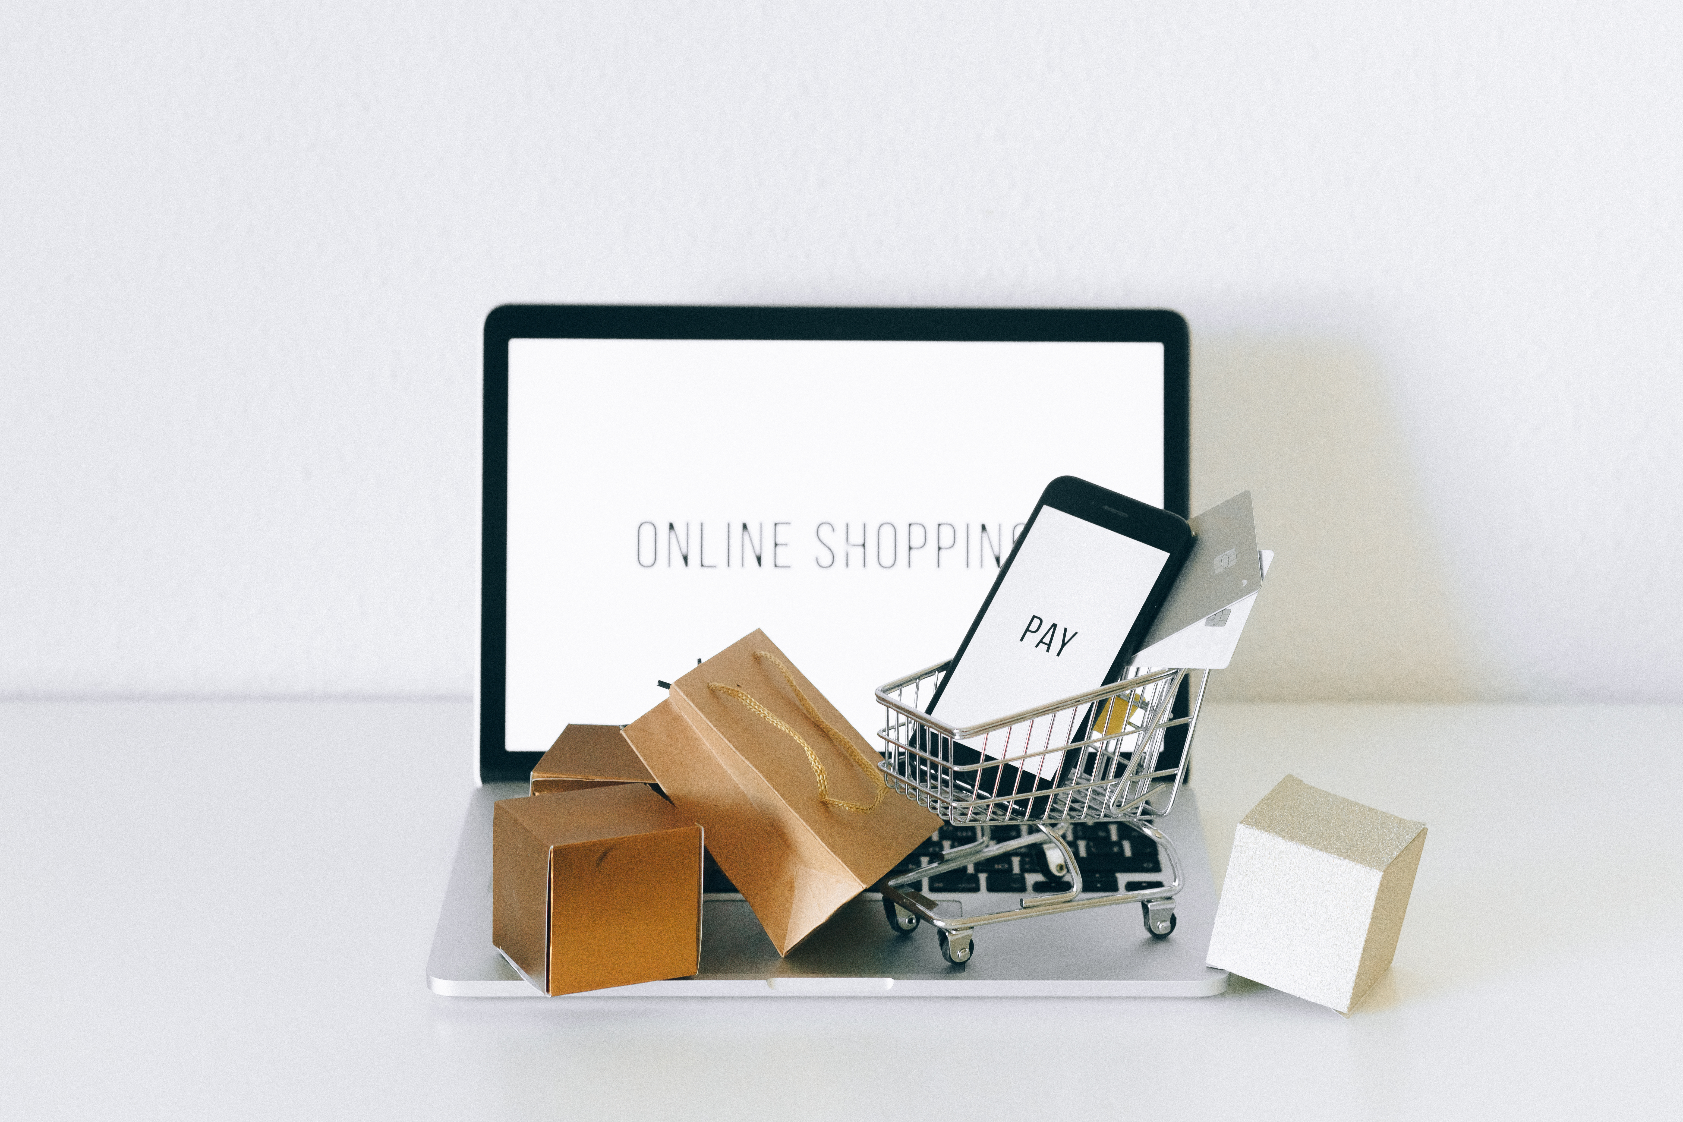
The Indian e-commerce market is estimated to reach USD 200 billion by 2026 and USD 350 billion by 2030 (E-commerce Industry Report, 2022), from the current value of USD 52.57 billion recorded in 2020.

Slide 5
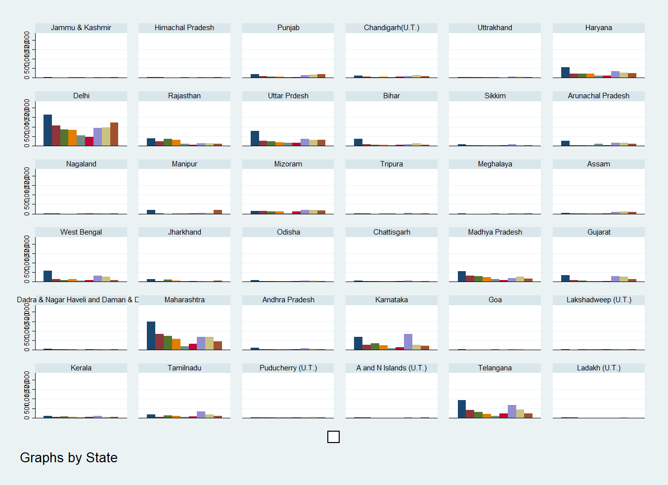
Graph showing the trends of online shopping among states and UT’s in India.

Slide 7
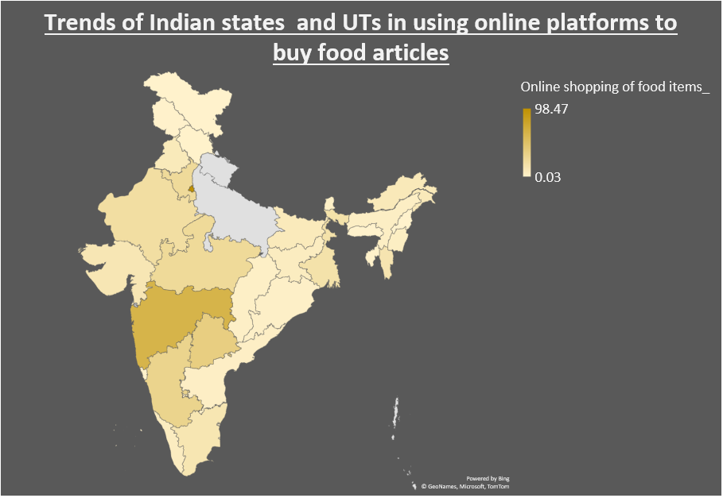

Slide 8
Analysis:
Delhi and Maharashtra use more online shopping for buying food articles than other states and UT’s in India.
Karnataka, Telangana, Haryana, Uttar Pradesh and Madhya Pradesh are the other states.
The microdata analysis shows that urban areas use online shopping to purchase food items more frequently than rural areas.
The NIQ Shopper Trends 2024 report found that 31% of urban Indians presently use quick commerce for their primary grocery shopping.
This trend has raised the growth of the grocery sector. However traditional retailers are affected negatively.

Slide 9
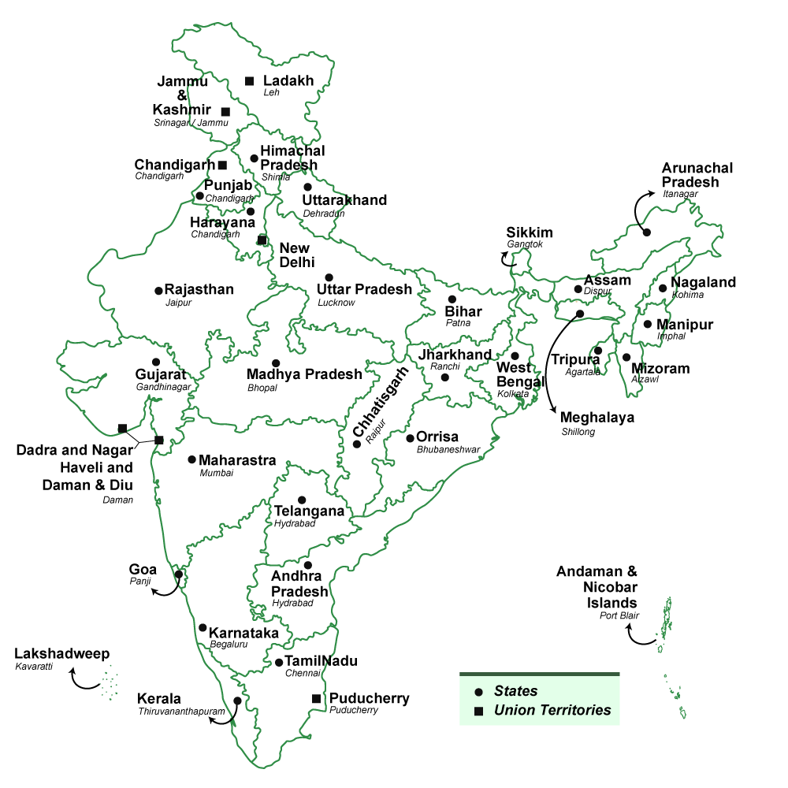

Slide 10
Due to the busy lifestyles and Covid-19 pandemic, the trend has intensified as urbanization and the need for social distancing have led more people to prefer online shopping over traditional in-store visits.

Slide 11
Long-term sustainability challenges for quick commerce or online grocery companies
Increase in carbon footprints
Minimum order size can lead to more food wastages (Impulsive buying)
Intense competition that negatively impacts the small scale retail stores.

Slide 12
Continuation of study:
The major objective is to suggest policies to make quick-commerce or online grocery shopping businesses more socially responsible, and environmentally sustainable.
For this primary data will be collected (and secondary data if available to related variables will be used).

Slide 13

Methodology
The type of data used for this study is the secondary data collection method and further primary methods will be employed for collecting micro data(using survey method).
A recent round of household consumption expenditure from 2022 to 23 data is used in the study.
Descriptive statistics, and graphical charts are presently used for analysis.
Further part of study might include case studies

Slide 14

Thank you

